Slide 1
IMAGES FOR NOTECARDS

Slide 2
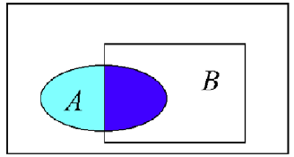
A = has the disease (blue)
B = tests positive (green)
False negatives
Correct positives
False positives

Slide 3
Θ = Θ1
Θ = Θ2
Θ = Θ3
X = X1
X = X1
X = X2
X = X1
X = X3
X = X2
X = X2
X = X3
X = X3

Slide 4
Estimator (F’n)
estimated value
Θ
Data {Xi}
Randomly generated
Loss (F’n)
True value
Θ
loss

Slide 5
Estimator (F’n)
True value
Θ
Loss (F’n)
Risk F’n
E(loss)

Slide 6
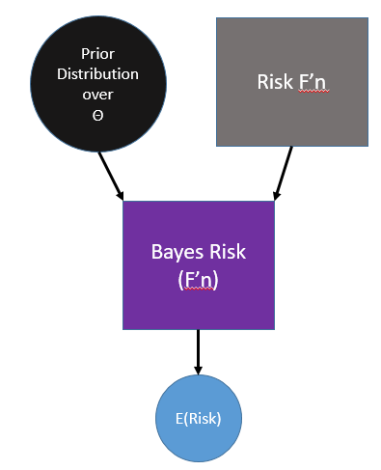
Estimator (F’n)
Loss (F’n)
Prior Distribution over
Θ
Risk F’n
Bayes Risk (F’n)
E(Risk)

Slide 7
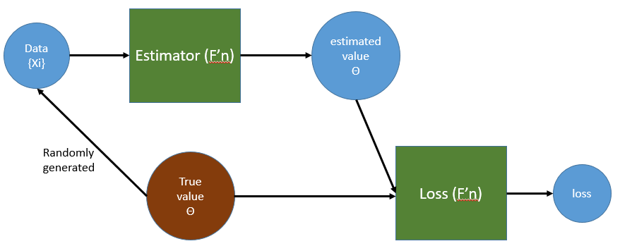
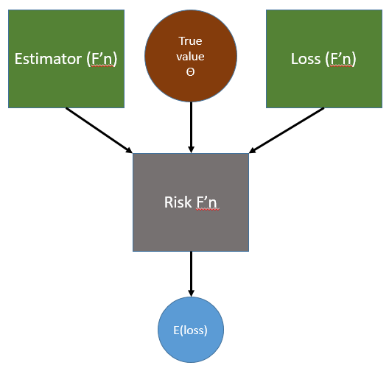
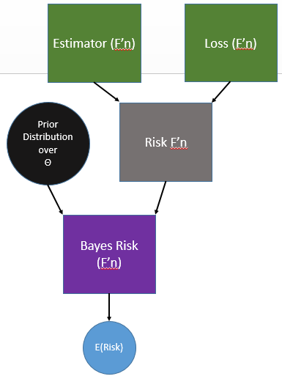

Slide 8
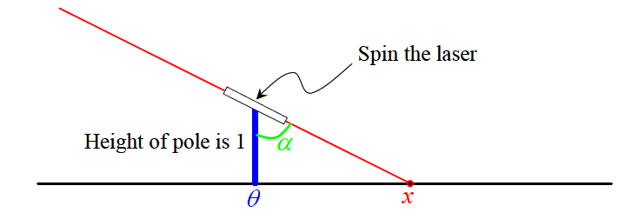

Slide 9
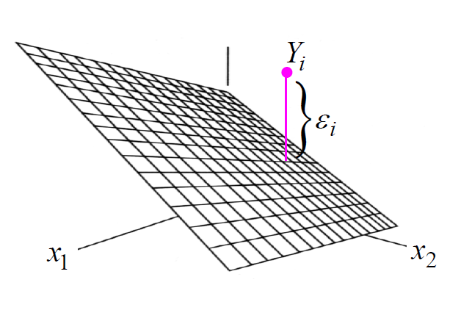
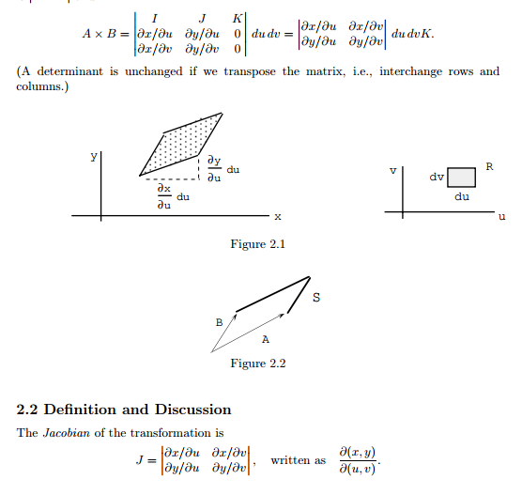

Slide 10
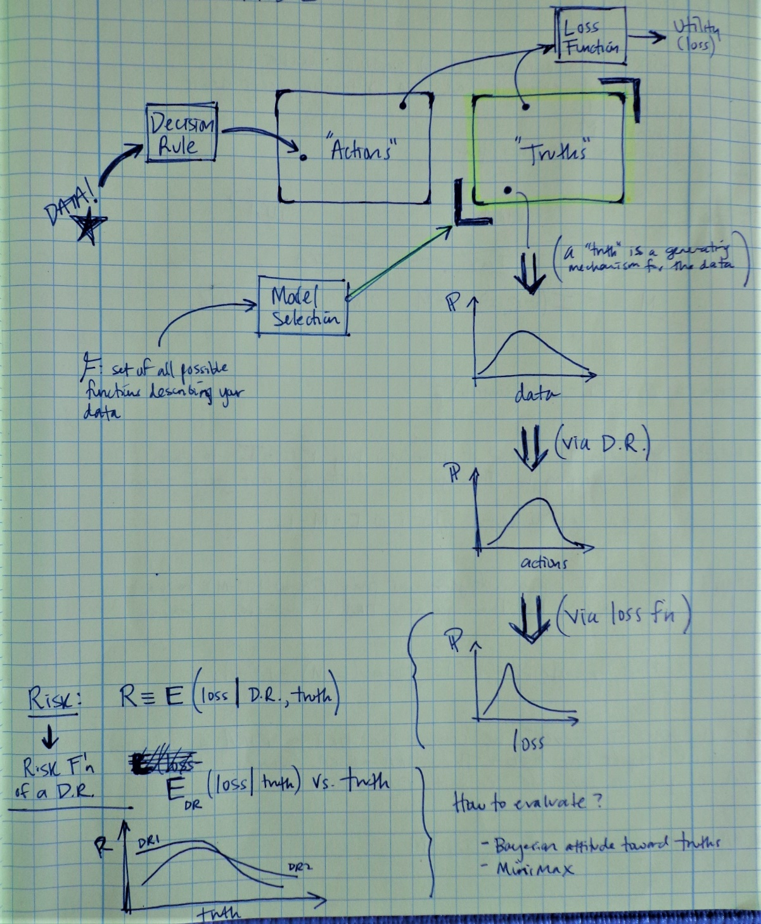
a DR inputs your specific observed data and outputs an action
a “truth” is a generating mechanism for the data thus any given truth implies a probability distribution on the data observed
Model selection chooses a subset of “truths” to consider from the space of all possible true generating mechanisms for your data
For a given DR, this implies a distribution on the actions
By also specifying a loss function, this implies a distribution on the loss
DRs can be compared by their risk curves over the space of truths. The minimax principle says choose the DR with the “best worst case”.

